Slide 1
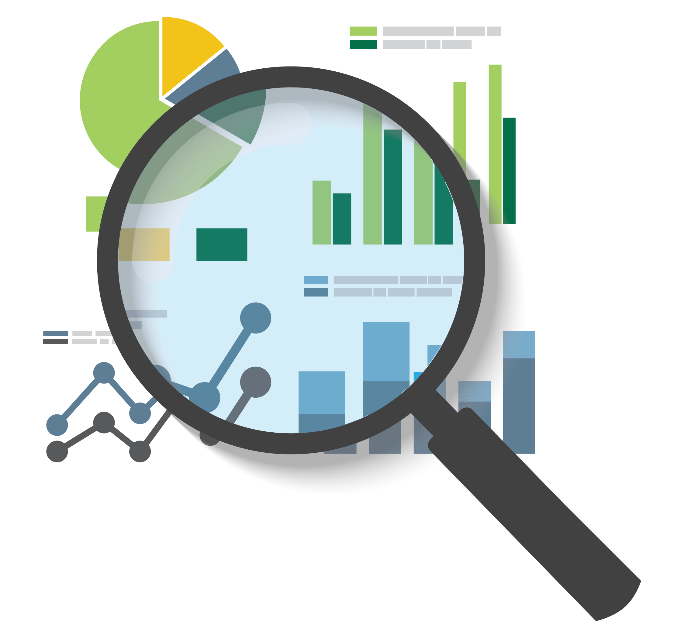
Kantar Hackathon
Group 3:
Coleen Toh Xuanting (A0188875A)
Colin Ng Chenyu (A0189871J)
Dai Linghao (A0177874J)
Daniel Seah Jieh Tzen (A0180335L)
Divyadarshini Thirugnanasambandan (A0184488L)
Douglas Wei Jing Allwood (A0183939L)
Notes:
Hello Everybody,
We are group 3 and we are glad to be presenting to you today.
Next Slide
This project aims to increase our client’s revenue by recommending an optimal food basket (in terms of cost and nutritional value) for our client’s customers.
Next Slide
Our approach is to first analyse and engineer features to identify traits of health-conscious customers.
Following which we can predict the health consciousness of a customer.
Then make recommendations based on whether the customer is health-conscious customers or non-health conscious
Next slide
Before we start, we must analyse and clean the data
Next Slide
Our data cleaning process was as follows:
* We noticed that there were some rows in which the money spent was zero. So, we dropped 1291 of those rows.
* Then there were a few rows of data where the volume purchased was 0, but spend and price per volume were present. So we estimated the volume purchased by dividing spend by price per volume.
* We also dropped 44,032 rows of duplicate data, because The presence of such data could affect the reliability of our models in the later part of the analysis.
Next Slide
As explained previously, we are focusing on identifying health conscious and non-health conscious customers.
And to do this, we require a metric based on the items that the customers buy.
So we engineered a feature called the Health Score.
Next Slide
To engineer this feature we needed more information about the nutritional value of the products.
The Categories Information dataset given to us provided information about calories and price of the product. As an extension to that dataset,
we web-scrapped more nutritional information about the products from myfitnesspal.com to get a better understanding of the sugar, fat and sodium values in the individual products.
Next Slide
Now that each product now has a total of 4 health-related attributes:
* calories/100g
* fats/100g
* sugar/100g
* sodium/100g
It is time to calculate the health score:
* First we standardized each of the four columns so that the 4 values are comparable
* Then, to make the scores more understandable, we translated each column so that each of their minimum values is one.
* Finally we multiplied the newly computed scores of the four attributes to find the final health score
* The multiplicative health score will compound the effects of every contributor (calories, fats, sugar, sodium)
For instance, a product with 3 low and 1 high attributes will have a lower health score than a product which has 2 low and 2 high attributes.
Next Slide
This is our final list of engineered health scores. The lower the health score, the healthier the product.
Next Slide
Moving on to labelling our customers
Next Slide
To label our customers, each customer needs to be assigned with a health score. The Health Score of a customer was calculated by taking the average of the Health Scores of all the items that the customer had previously bought.
This is the histogram of each customer’s health score. As you can see the health scores of customers have a normal distribution
Next Slide
To ensure that the customers are well segmented, we labelled the top 30 percentile as our Non-Health Conscious cuztomers and the bottom 30 percentile as our Health Conscious customers. After doing this, we had an equal number of 971 customers in each cluster.
Now I’m going to pass my time to Douglas to talk more about our predictive algorithm, data-driven recommendations and impact analysis.
What Divya has been talking about so far is how we use existing transaction data of existing customers to classify them as health-conscious or not.
What ill be expanding on is how we perform this same customer segmentation for new customers, who we dont have any past transaction data of.
So this requires prediction.
After this, ill go through the data driven recommendations that this health-based segmentation has allowed us to identify.
Next Slide
Firstly, we’ll be using a classification tree to predict whether a new customer is health-conscious or not.
We’ll used the 7 predictor variables shown on the screen that are about a customer demographics.
Such demographic data could be collected from new customers if they sign up for a membership card, or mobile app, with our client.
A pictorial view of what this table looks like is shown below.
So for every customer, we want to predict their health status
Next Slide
The results on the screen are the outcome of testing the trained classification tree on a test set.
We see that the scoring metrics are above 70% across the board.
The implication of this predictive capability is that given a new customer’s demographic information, our client will be able to predict their health consciousness correctly 73% of the time.
Lets now look at the model that was trained
Next Slide
This is what our tree looked like, after we tuned the parameters.
You can see the purity of the nodes is mostly good except for the node at the bottom right in light blue that does not have very good separation.
We see that most of the decisions made by the decision tree were based on geographical location.
Next Slide
There are two main parameters we selected:
We used the the gini splitting criterion because it aims to split and produce groups that are as different as possible, which is exactly what we want for our binary classification problem
We required each split to have a minimum of 900 samples, so that when predicting for a new customer we would know that there are many other customers with similar demographics and using this value would also avoid overfitting
Next Slide
So now we've seen how we predict the segmentation of a new customer, but what is the impact of this prediction for our client?
Next Slide
Well, looking at the data, our client gets an average of 9.68 new customers each month.
This means that our model could correctly predict the health conscious status of 7 new customers per month, or 84 per year.
Assuming a 10% success rate for marketing campaigns that have been targeted to a correctly labelled customer we derived the following impact estimate of 450 successful marketing recommendations to new customers per year.
Additionally, the improved customer experience of receiving good recommendations could lower our clients current churn of about 9.31 customers per month.
So what kind of marketing recommendations could our client then make?
Next Slide
Our first recommendation involves upselling a basket of healthy items to customers who are both health-conscious and high spenders.
Next Slide
To do this, we examine the top purchases made by customers who are both health-conscious and high spenders.
We then identified the following 5 common necessities but noticed that instant noodles and sugar fare poorly in terms of our health scores.
We then recommended replacing these two unhealthy items with healthier and more expensive items.
Replace instant noodles with instant soup
Replace sugar with honey
Next Slide
Given this final optimal food basket of rice, flour, honey, eggs, and instant soup.
If our client sold it at a 10% discount, and we assume a modest 2% take-up rate amongst our 319 high spending health conscious customers, and if we offer this promotion every month, we expect it to generate $4,600 per year.
Next Slide
Next we have this healthy trade-up recommendation which is a 1 to 1 upselling scheme.
Next Slide
We once again analysed health-conscious high spenders, but this time with Market Basket Analysis to learn their past spending patterns.
We noticed that if they bought some items like biscuits and sugar, they were 4 times more likely to buy items like canned products.
However, canned products are not very healthy.
So, given that the customer is 4 times more likely to buy canned products once he buys biscuits and sugars, why not recommend a healthier substitute instead?
Next slide
To recommend a healthier substitute we identified the categories of items present in our data set, so that we could identify healthier replacements from the same category.
There were 7 categories we came up with, the last being “non-replaceable”, items that cannot be replaced and hence are excluded from this up-selling campaign.
Next slide
These are examples of our list of items with healthier items at the top
So if someone’s MBA indicated that based on the items they have in their cart, they are likely to want to buy a spread like chocolate, then we could recommend one like kaya instead.
Next slide
The impact of this recommendation system can be understood by the following:
We are recommending on items with lift greater than 1 and the substitutes are from the same category, making the recommendation highly likely to be successful
The substitute is healthier and hence will appeal to health-conscious customers
Lastly, we will only recommend items that generate more revenue for our client, an approximate $2 increase in price on average.
So putting these together, we expect our client’s health-conscious high spenders to spend an additional $3,300 annually.
Next slide
Lastly, for customers who are not health conscious, we could just use any profit maximizing MBA to make recommendations
Next slide
Next slide
This is a summary of the impacts i have discussed.

Slide 2
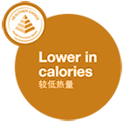
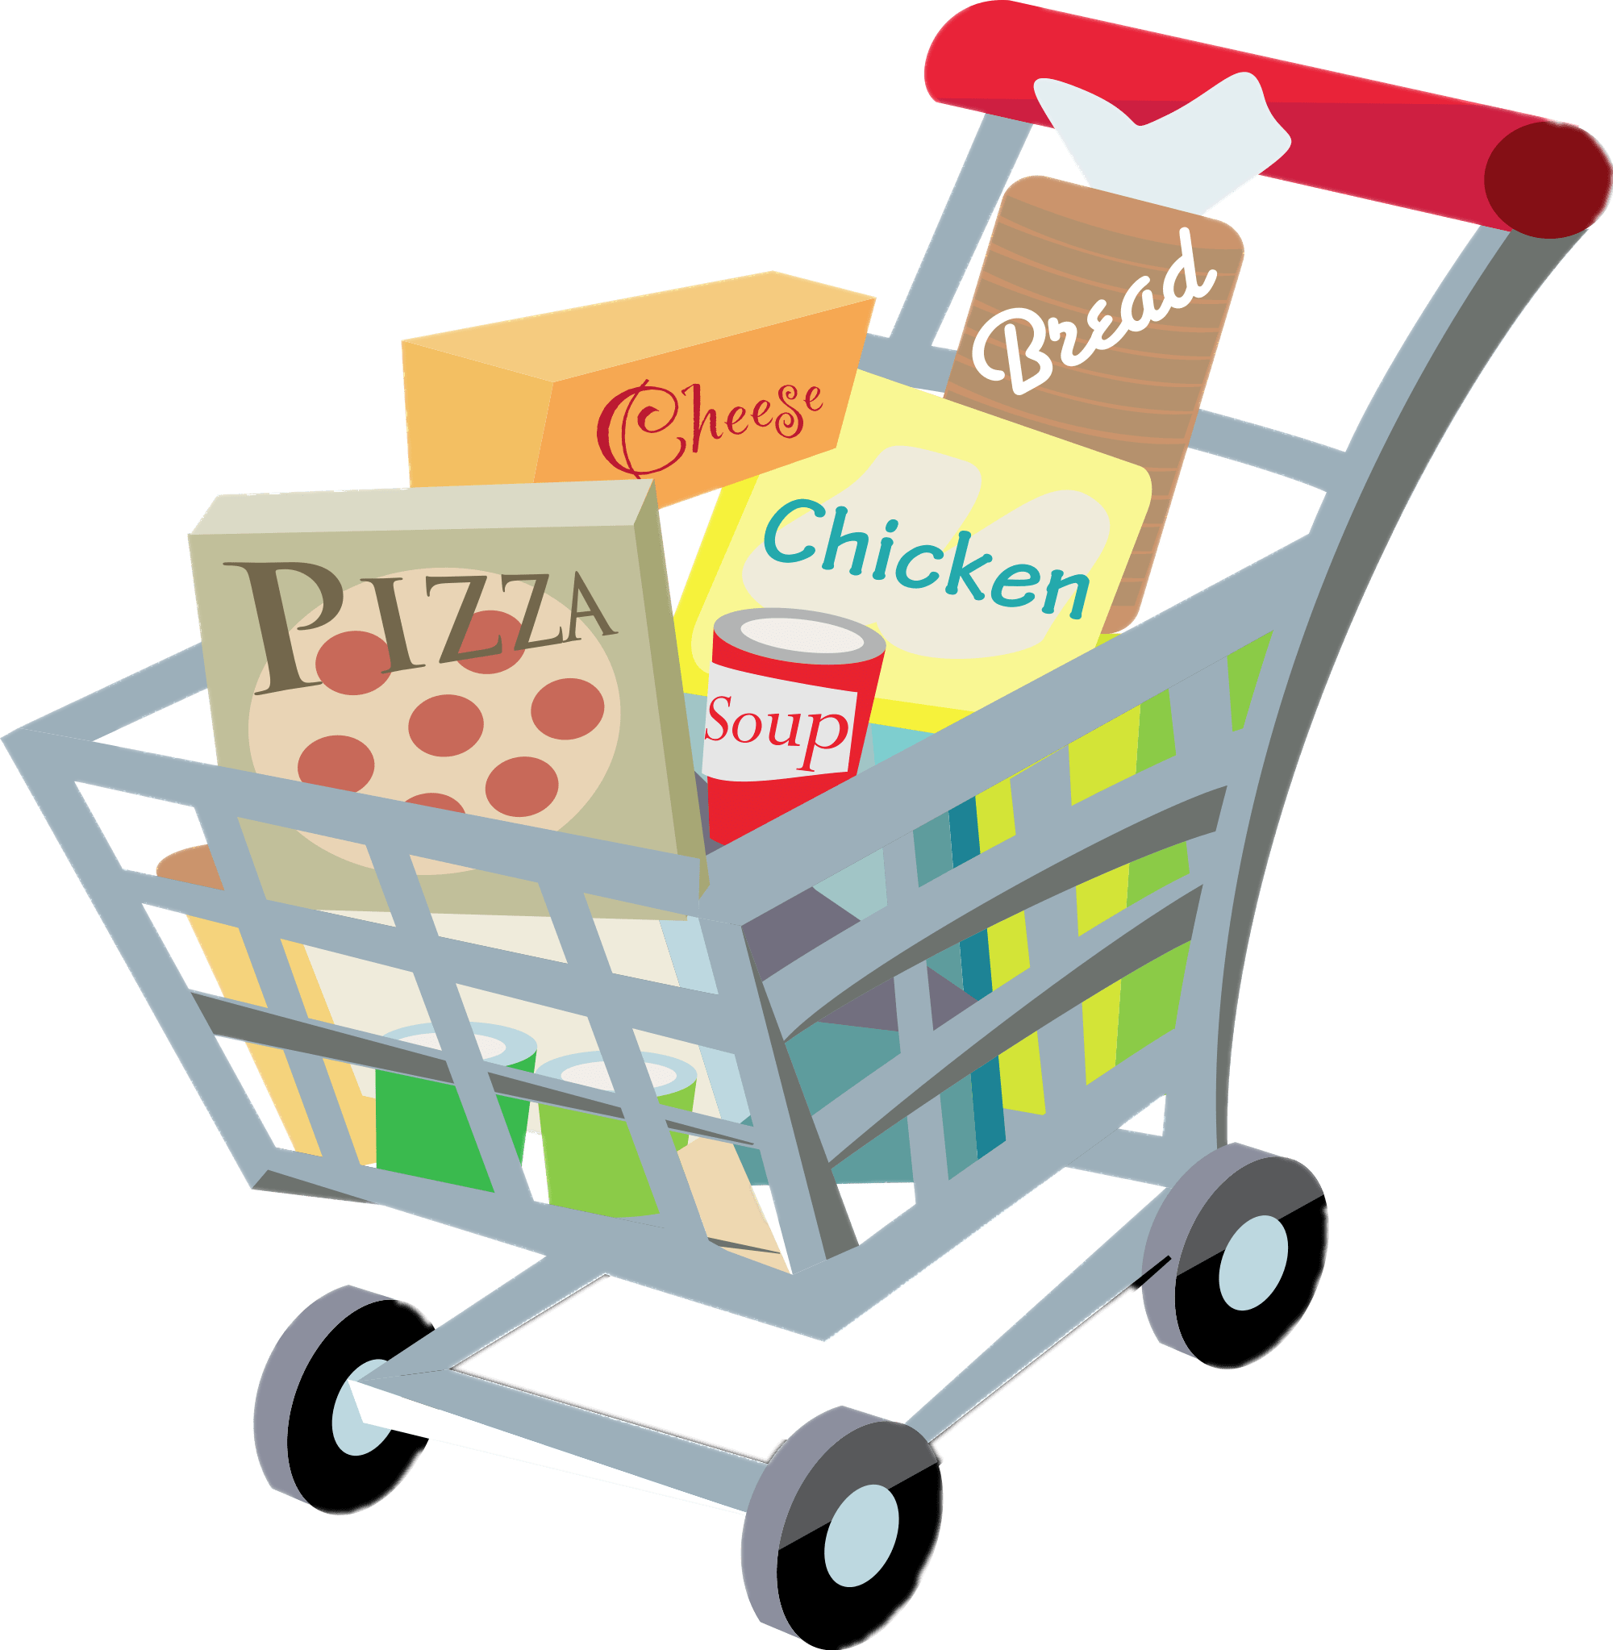
This project aims to group our client’s customers based on health-consciousness and then recommend an optimal food basket (in terms of cost and nutritional value) for each customer group.

Slide 3

Approach
Engineering & Analysis
Customer Segmentation
Recommendations
Discounted healthy basket
Health-conscious
Identify traits of health-conscious customers
Healthy trade-up
Not health-conscious
Profit maximizing MBA
Notes:
Our approach is to first analyse and engineer features to identify traits of health-conscious customers.
Following which we can predict the health consciousness of a customer
Then make recommendations based on whether the customer is health-conscious customers or non-health conscious

Slide 4

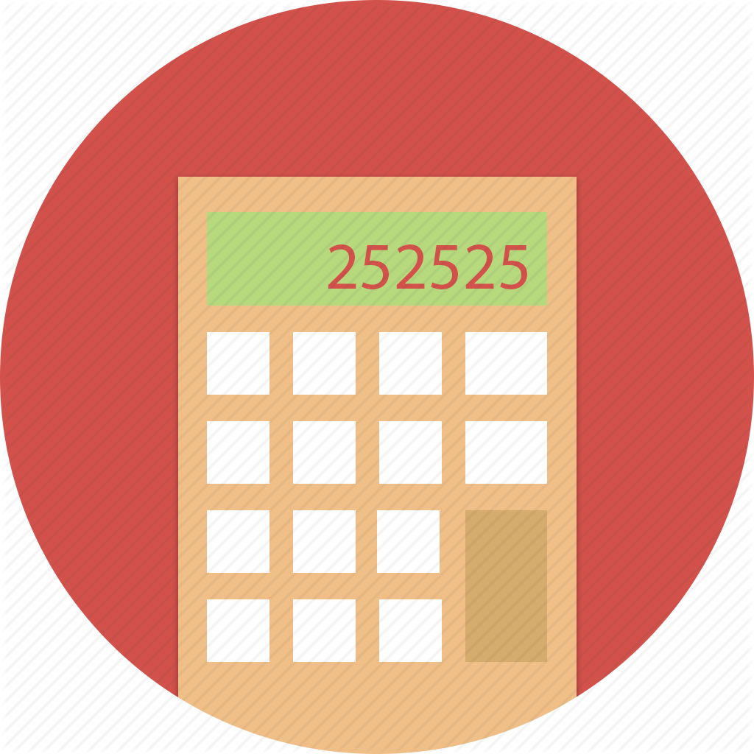

Data Cleaning
Dropped rows that had spend = 0
Estimating volume purchased
Deleting duplicate rows
The presence of such data would affect the reliability of our models in the later part of the analysis.
A total of 1291 rows of data were dropped.
There were a few rows of data where the volume purchased was 0.
We estimated the volume purchased by dividing spend by price per volume.
The presence of such data would affect the reliability of our models in the later part of the analysis.
A total of 44,032 rows of duplicated data were dropped.
Notes:
Our data cleaning process was as follows.
We noticed that there were some rows in which the money spent was zero. So, we dropped 1291 of those rows.
Then there were a few rows of data where the volume purchased was 0, but spend and price per volume were present. So we estimated the volume purchased by dividing spend by price per volume.
We also dropped 44,032 rows of duplicate data, because The presence of such data could affect the reliability of our models in the later part of the analysis.

Slide 5

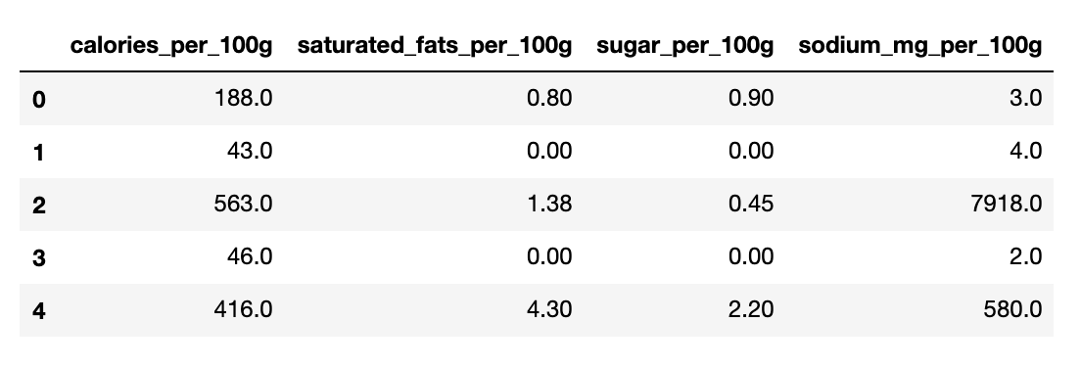
Addition of web-scraped data to our products dataset
Each product now has a total of 4 health-related attributes:
calories/100g
fats/100g
sugar/100g
sodium/100g
Notes:
We web-scrapped information about the products from myfitnesspal.com to get a better understanding of the nutritional value of the individual products.
This was an extension to the Categories Information dataset provided to us.

Slide 6
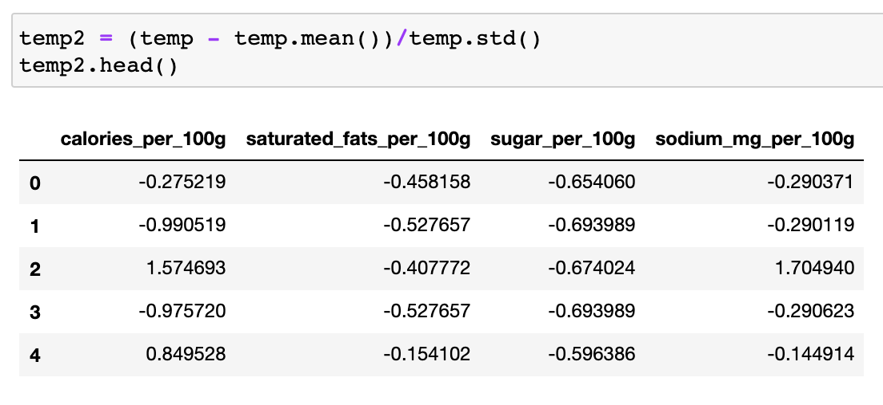
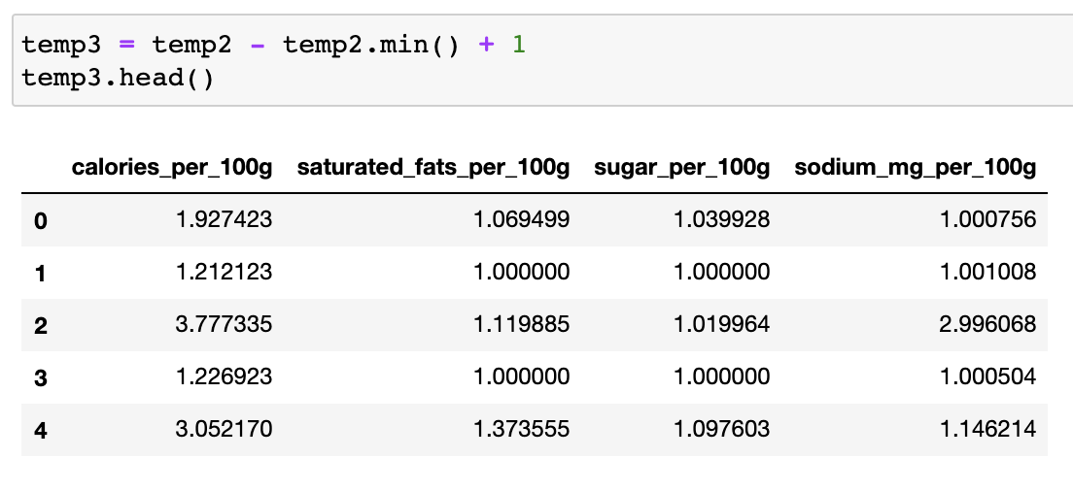

Engineering the health scores
Lower health score = healthier product
Standardize each of the four columns
Translate each column so that each of their minimum values is 1
Multiply the scores of the four attributes to find the final health score
Subtracting mean and then dividing by standard deviation
Subtracting the minimum value and then adding 1 to it
Calories × Saturated_Fats × Sugar × Sodium = Health_Score
A multiplicative Health Score will compound the effects of every contributor.
Health Score for each product would be
≥ 1 since the smallest value possible is 1×1×1×1=1.
Notes:
Each product has 4 health-related attributes
First we standardized each of the four columns by subtracting mean and then dividing by standard deviation.
Then we translated each column so that each of their minimum values is one.
Finally we multiplied the newly computed scores of the four attributes to find the final health score
The multiplicative health score will compound the effects of every contributor (calories, fats, sugar, sodium)
For instance, a product with 3 low and 1 high attributes will be lower than a product which has 2 low and 2 high attributes. (e.g. 1×1×1×10 =10 is less than 1×1×5×5 = 25).

Slide 7
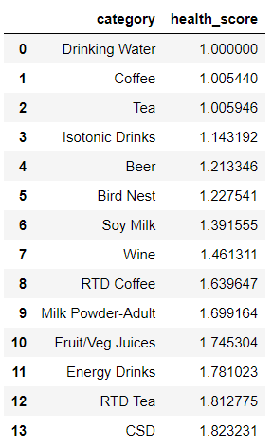
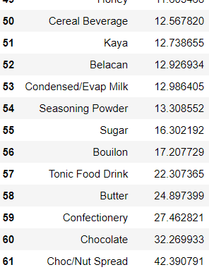
Engineered health scores
Head
Tail
Notes:
This is our final list of engineered health scores

Slide 8
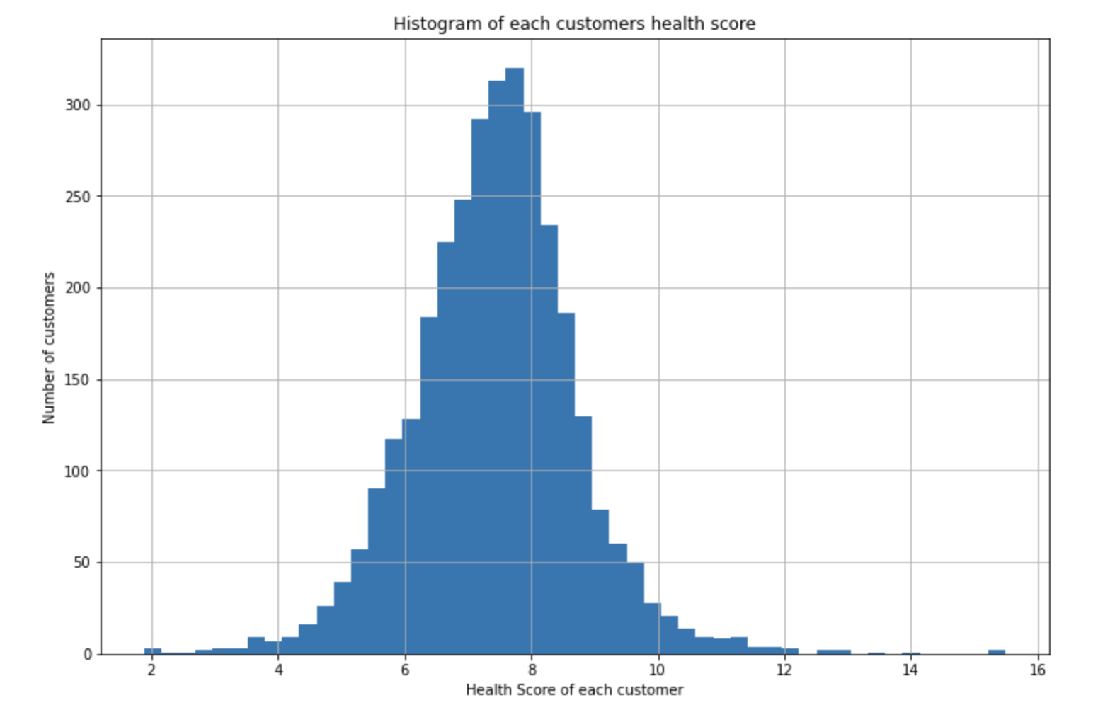
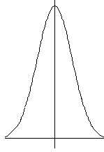

Health score of a customer
The Health Score of a customer was calculated by taking the average of the Health Scores of all the items that the customer had previously bought.
Heath scores of the customers are normally distributed

Slide 9

Health-conscious and non-health conscious customers
Cluster | Cluster Label | Health Score Range | Number of customers
0 | Health conscious | Below median | 1618
1 | Non-Health Conscious | Above median | 1618
Health conscious
Non-health conscious

Slide 10
Approach
Engineering & Analysis
Customer Segmentation
Recommendation
Discounted healthy basket
Health-conscious
Identify traits of health-conscious customers
Healthy trade-up
Not health-conscious
Profit maximizing MBA
Notes:
What Divya has been talking about so far is how we used existing transaction data of existing customers to classify them as health-conscious or not.
What ill be expanding on is how we perform this same customer segmentation for new customers, who we dont have any past transaction data of.
So this requires prediction.
After this, ill go through some data driven recommendations that this health-based segmentation has allowed us to identify.

Slide 11
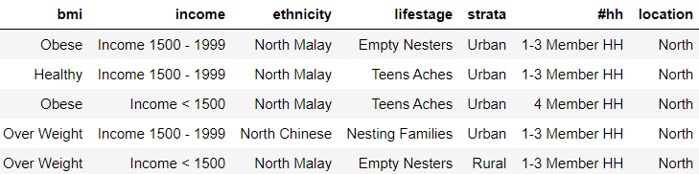
Predicting health-consciousness
BMI
Ethnicity
Income
Health Conscious
Classification Tree
Not health conscious
Location
Lifestage
Strata
Household size
Notes:
Firstly, we’ll be using a classification tree to predict whether a new customer is health-conscious or not.
We’ll use the 7 predictor variables shown on the screen that are about a customer demographics.
Such demographic data could be collected from new customers if they sign up for any membership cards with our client, however as you will later see, such membership programmes wont really be necessary.
A pictorial view of what this table looks like is shown below.
So for every customer, represented by a row in the table, we want to predict their health-consciousness.
Either they are health-conscious or they are not.

Slide 12

Predicting health-consciousness
Some tuning parameters:
Gini splitting criterion
Minimum of 100 samples per split
Minimum of 100 samples per leaf
Notes:
To train the classification tree were three parameters we selected:
We used the the gini splitting criterion because it aims to split and produce groups that are as different as possible, which is exactly what we want for our binary classification problem
We required each split to have a minimum of 100 samples
And we required each leaf node to have a minimum of 100 samples.
The benefits of these parameterizations are so that when predicting for a new customer we would know that there are many other customers with similar demographics and outcomes, and also this helps prevent overfitting
Ok, so now lets look at the results that were produced

Slide 13
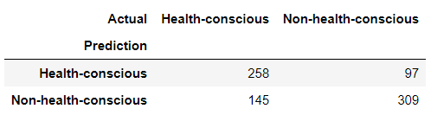
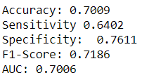
Predicting health-consciousness
Implication:
Given a new customer’s demographic information, our client will be able to predict with ~70% certainty their health consciousness.
Notes:
What youre seeing on the slide are the outcomes of testing the trained classification tree on a test set.
We did a 75%-25% train test split.
We see that the scoring metrics are mostly above 70%, except for sensitivity at 64%.
The implication of this predictive capability is that given a new customer’s demographic information, our client will be able to predict their health-consciousness correctly about 70% of the time.
We’ll now look at the model that was trained to see if there are any insights that we can gather.

Slide 14
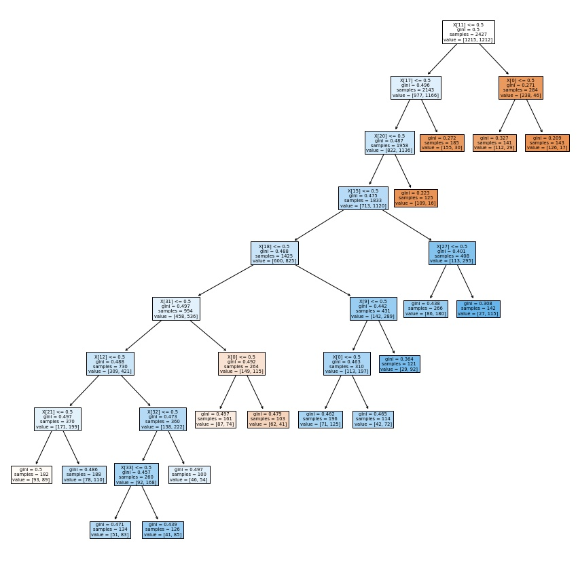
Classification Tree
X[11]: Ethnicity - Central Chinese
X[0]: BMI - Healthy
Blue Leaf: Not health-conscious
Orange Leaf: Health-conscious
X[17]: Ethnicity - North Chinese
X[20]: Ethnicity - South Chinese
X[15]: Ethnicity - East Coast Malay
X[27]: Lifestage- Teens and toddlers
X[18]: Ethnicity - North Malay
X[0]: Income - < 1500
X[31]: Household size: 1-3 Members
X[0]: BMI - Healthy
X[0]: BMI - Healthy
X[12]: Ethnicity - Central Malay
X[32]: Household size: 4 Members
X[21]: Ethnicity - South Malay
X[33]: Household size: 5 Members
Notes:
This is what our tree looked like, after we tuned the parameters.
Looking at the leaf nodes, Orange represents health-conscious while blue represents not-health conscious.
You can see that most of the health conscious customers are identified in the first few leaf nodes, and the purity of these leaf nodes is decent.
We see that most of the decisions made by the decision tree were based on ethnicity that comprised race and geographical location
Looking at this, it might make sense for the client to further investigate if shopping behaviours are truly different according to these geographical and ethnic attributes.
If so, perhaps stocking stores in different parts of the country for the local preferences may be a sensible thing to do.
A caveat here, is that looking at this we were pretty suspicious that we got such good separations in predicting customer health-consciousness.
We do wonder whether our feature engineering process of multiplying the standardized health scores of items may have been inadvertently correlated with racial preferences for food items.
If so, this would be an interesting finding and would perhaps warrant further investigations.

Slide 15
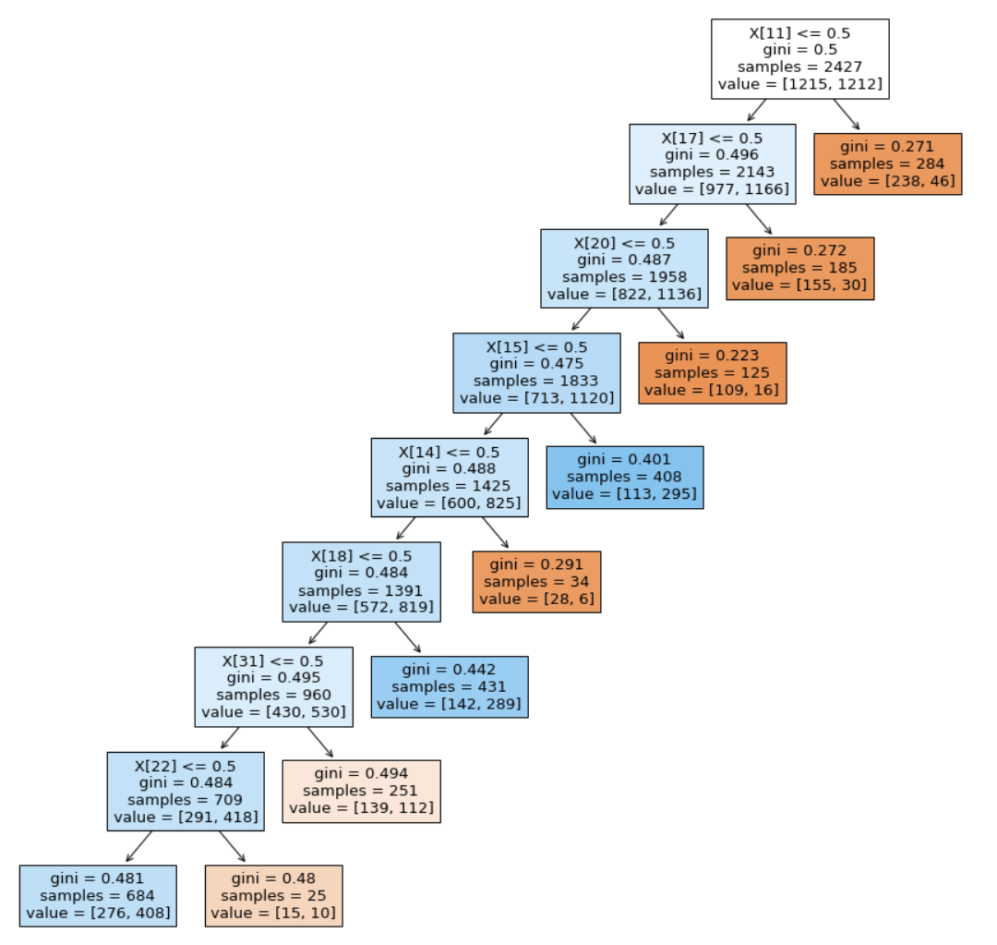
Classification Tree
Blue Leaf: Not health-conscious
Orange Leaf: Health-conscious
X[11]: Ethnicity - Central Chinese
X[17]: Ethnicity - North Chinese
X[20]: Ethnicity - South Chinese
X[15]: Ethnicity - East Coast Malay
X[14]: Ethnicity - East Coast Chinese
X[18]: Ethnicity - North Malay
X[31]: Household size: 1-3 Members
X[22]: Ethnicity - South Others
Notes:
This is what our tree looked like, after we tuned the parameters.
You can see the purity of the nodes is mostly good except for the last few nodes.
We see that all except one of the decisions made by the decision tree were based on geographical location.

Slide 16
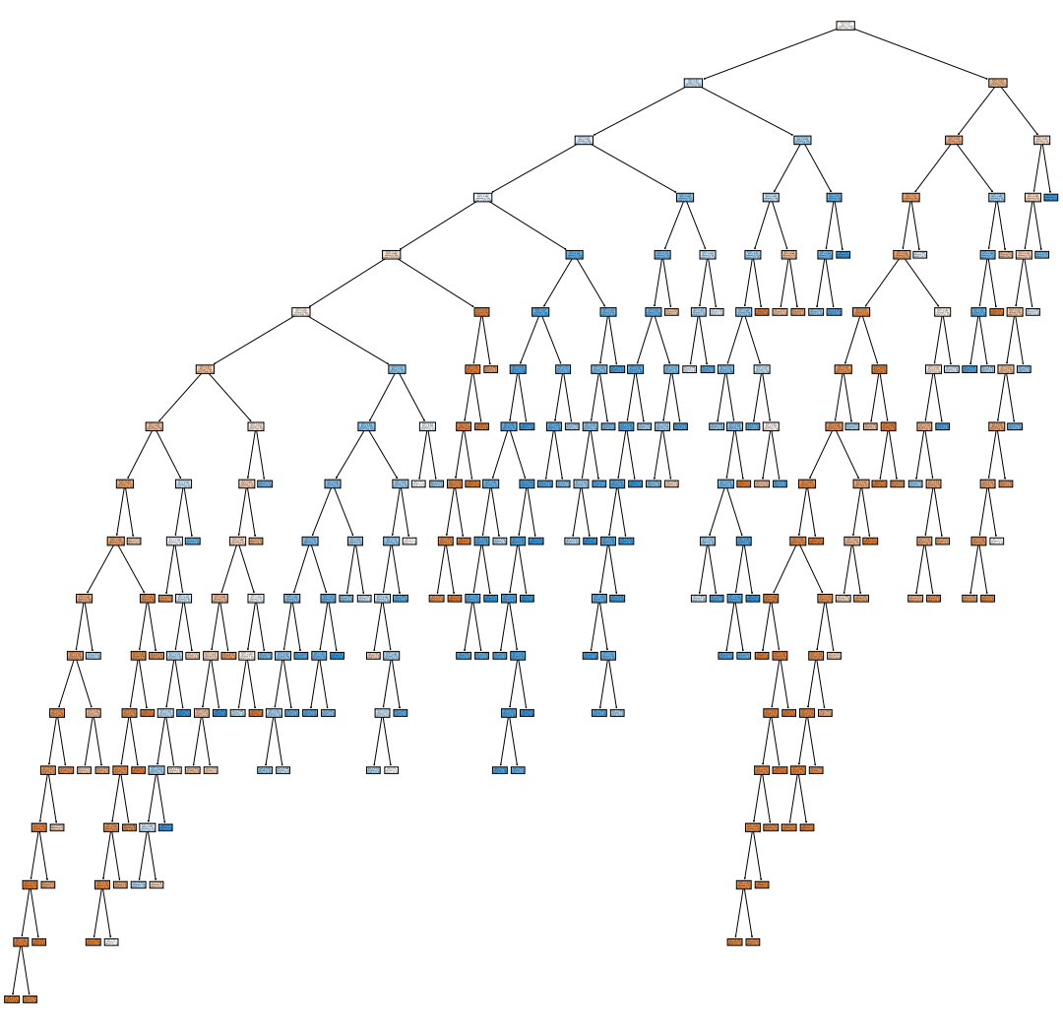
Predicting health-consciousness
The resulting tree is too complex to visualise
Notes:
As you can see, because we had 7 predictor variables and over a thousand customers to train on, the tree is rather extensive.
So Instead of focusing on the output tree which we know performs well, I will discuss the parameterization inputs that we used to develop the tree.

Slide 17
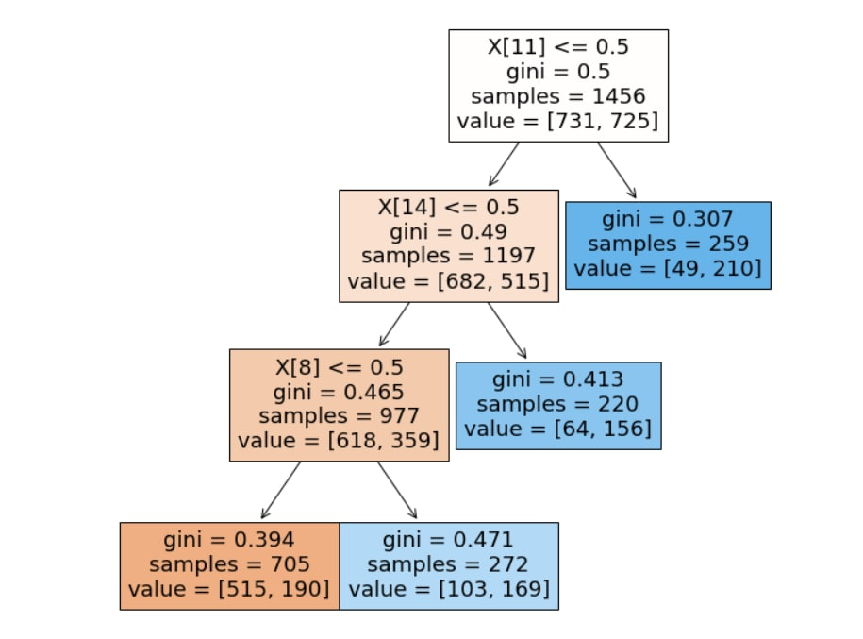
Classification Tree
Blue Leaf: Not health-conscious
Orange Leaf: Health-conscious
X[11]: Ethnicity - East Coast Malay
X[14]: Ethnicity - North Malay
259 samples are East Coast Malay
X[8]: Ethnicity - Central Malay
220 Samples are North Malay
705 samples are contain the rest of the data
Majority of them are health-conscious
272 samples are Central Malay
Notes:
This is what our tree looked like, after we tuned the parameters.
You can see the purity of the nodes is mostly good except for the node at the bottom right in light blue that does not have very good separation.
We see that most of the decisions made by the decision tree were based on geographical location.

Slide 18

Impact Analysis

Slide 19
Approach
Engineering & Analysis
Customer Segmentation
Recommendation
Discounted healthy basket
Health-conscious
Identify traits of health-conscious customers
Healthy trade-up
Not health-conscious
Profit maximizing MBA
What is the impact of accurate customer segmentation?
Notes:
So now ive explained how we can predict the segmentation of a new customer, but what is the impact of this prediction for the client?

Slide 20
Prediction Benefit
Improved targeting of marketing campaigns may increase sales
Improved Customer Experience may lower current churn rate
From the data:
9.68 new customers every month
Customers mostly visit every 1 to 2 weeks
For 70% prediction accuracy, 7 new customers can be correctly labelled each month (84 per year)
9.31 churned customers every month
Notes:
First off, being able to better identify the preferences of customers will allow for improved targeting of marketing campaigns.
For example, trying to sell healthy items to health conscious customers is far more likely to be successful than trying to market healthy items to a customer who dont care.
Secondly, the improved customer experience of receiving relevant recommendations may help lower the current churn rate.
To further substantiate these benefits, we now look to the data which show that the client does indeed receive new customers every month, averaging at about 9.68 per month.
Also, because most customers visit every 1 to 2 weeks, being able to accurately recommend them something relevant every week may help improve sales.
Perhaps this could be done by sending promotional flyers to their homes, or by simply stocking stores in different geographies with different items and offering different promotions each week.
Given a 70% prediction accuracy, this means that our client may be able to use demographic data (mainly the location of the store and the race of the customer) to correctly predict the health-consciousness of 7 new customers per month, or 84 per year.
Lastly, from the data we also saw that our client has a churn rate of about 9.31, which is comparable to the number of new customers every month.
By making more relevant recommendations, it may improve the customers shopping experience and reduce churn, though this is subjective because we do not know what is causing current churn rates.
Okay, so now that we’ve got prediction of health-consciousness down, what kind of marketing strategies might the client employ?

Slide 21
Approach
Engineering & Analysis
Customer Segmentation
Recommendation
Discounted healthy basket
Health-conscious
Identify traits of health-conscious customers
Healthy trade-up
Not health-conscious
Profit maximizing MBA
How can we up-sell to health-conscious customers?
Part 1
Notes:
The first recommendation we have for the client is to consider upselling a basket of healthy items to health-conscious customers.

Slide 22
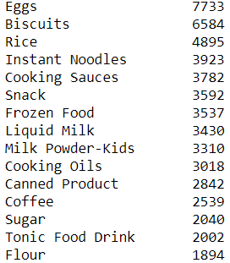
Discounted health-basket
Customers who are both High spenders & Health Conscious
Optimal food basket: Rice, Flour, Honey, Eggs, Instant Soup
Top purchases:
Replace with healthier and more expensive alternative: Instant Soup
Replace with healthier and more expensive alternative: Honey
Notes:
The idea is simple, look at what health conscious customers normally buy, bundle these with a few items “upgraded” for better health benefits to the customer, and better profit margins for the client.
To do this, we examined the top purchases made by customers who are both health-conscious and high spenders.
We then identified the following 5 common necessities but noticed that instant noodles and sugar fared poorly in terms of our health scores.
We hence recommend replacing these two unhealthy items with healthier and more expensive items.
Replace instant noodles with instant soup
Replace sugar with honey

Slide 23
Discounted health-basket
High spenders
Optimal food basket: Rice, Flour, Honey, Eggs, Instant Soup
Sell at a discount
Package the items together so they are easier to carry
Place these near the entrance
If a customer wanted to just buy 4 of the items, then given the discount, the convenience, and the health benefits, the customer might just buy the whole basket including the 5th items
Notes:
Given this final optimal food basket of rice, flour, honey, eggs, and instant soup.
Some things the client could do are to sell this basket at a discount, package the items together perhaps in a single basket, and place this basket near the entrance.
This way, if a customer wanted to buy just 4 of the items, then given the discount, the convenience, and the health benefits, the customer might just buy the whole basket including the 5th item.
In this manner, the client would have successfully cross-sold the client an additional item, and upsold them on the two healthier and more costly items.

Slide 24
Approach
Engineering & Analysis
Customer Segmentation
Recommendation
Discounted healthy basket
Health-conscious
Identify traits of health-conscious customers
Healthy trade-up
Not health-conscious
Profit maximizing MBA
How can we up-sell to health-conscious customers?
Part 2
Notes:
Next we have a healthy trade-up recommendation which is a 1 to 1 upselling scheme.

Slide 25
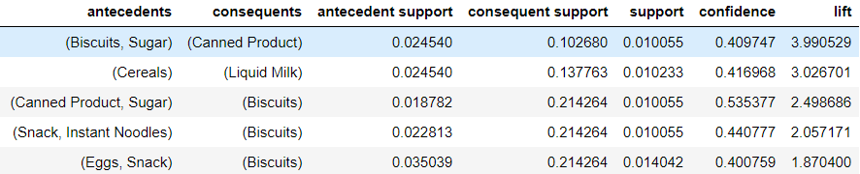
Healthy Trade-up Recommendation
High spenders & Health Conscious
Market Basket Analysis
What can we do with these purchasing patterns?
Notes:
For this healthy 1-1 trade up, we once again analysed health-conscious high spenders, but this time with Market Basket Analysis to learn their past spending patterns.
We noticed that if they bought some items like biscuits and sugar, they were 4 times more likely to buy items like canned products, as shown by the lift of 4.
However, canned products are not very healthy.
So, given that the customer is 4 times more likely to buy canned products once he buys biscuits and sugars, why not recommend a healthier substitute instead?

Slide 26
Healthy Trade-Up
Categories
Drinks
Milk
Spreads
Snacks
Food
Cooking Items
Non-replaceable
To aid in making sensible recommendations for healthier alternatives to our customers we manually grouped the products into 6 product categories.
We excluded items such as eggs and flour from the grouping because they are “non-replaceable” in the given product list.
Notes:
To recommend a healthier substitute we identified the categories of items present in the dataset, so that we could identify healthier replacements from the same category.
There were 7 categories we identified, the last being “non-replaceable”, items that cannot be replaced and hence are excluded from this up-selling campaign.

Slide 27
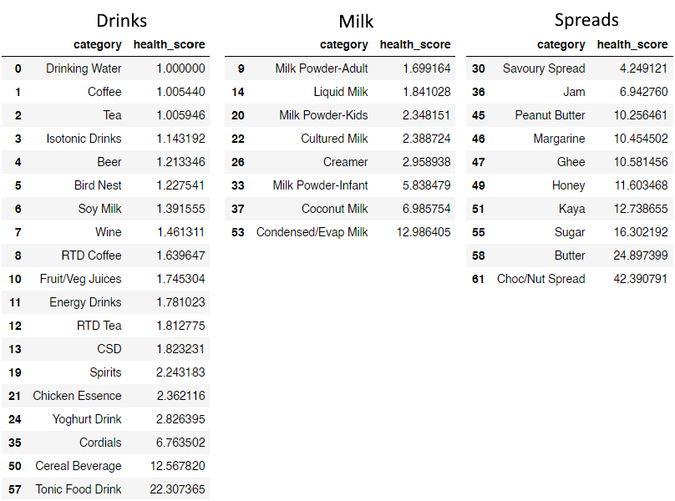
Healthy Trade-Up
Healthier alternative
Example of 3 manually grouped categories
Notes:
These are examples of our list of items with healthier items at the top
So if someone’s MBA indicated that based on the items they have in their cart, they are likely to want to buy a spread like chocolate, then we could recommend one like kaya instead.

Slide 28
Healthy trade-up
High spenders
Market Basket Analysis
Original item to be substituted has lift greater than 1
Recommended substitutes are from the same category
Substitute is healthier & appeals to health-conscious customers
Item generates more revenue for our client
This 1-1 recommendation could be performed by placing the substitute items beside the original items in the store, and clearly identifying them as healthier options
Notes:
The impact of this recommendation system can be understood by the following:
We are recommending on items with lift greater than 1 and the substitutes are from the same category, making the recommendation highly likely to be successful
The substitute is healthier and hence will appeal to health-conscious customers
Lastly, we will only recommend items that generate more revenue for the client
So, this 1-1 recommendation could be performed by placing the substitute items beside the original items in the store, and clearly identifying them as healthier options

Slide 29
Healthy trade-up
High spenders
Market Basket Analysis
Original item to be substituted has lift greater than 1
Recommended substitutes are from the same category
Substitute is healthier & appeals to health-conscious customers
Item generates more revenue for our client (approx $2 increase in price)
$2 x 10% success rate x 319 customers x 52 weeks = $3,300 annually
Notes:
The impact of this recommendation system can be understood by the following:
We are recommending on items with lift greater than 1 and the substitutes are from the same category, making the recommendation highly likely to be successful
The substitute is healthier and hence will appeal to health-conscious customers
Lastly, we will only recommend items that generate more revenue for our client, an approximate $2 increase in price on average.
So putting these together, we expect our client’s health-conscious high spenders to spend an additional $3,300 annually.

Slide 30
Approach
Engineering & Analysis
Customer Segmentation
Recommendation
Discounted healthy basket
Health-conscious
Identify traits of health-conscious customers
Healthy trade-up
Not health-conscious
Profit maximizing MBA
Notes:
Lastly, for customers who are not health conscious, we could just use any profit maximizing MBA to make recommendations.
This is because its safe to assume that these customers wouldnt mind being recommended unhealthy items like chocolate spread or ice cream.
We wont be discussing this option in greater detail because the focus of our analysis was on health-conscious customers.
Finally, such “recommendations” could be implemented by placing recommended items next to the original items in the store layout and including a sign telling customers why they should consider the recommendations instead.
For example, by promoting them as healthier options.

Slide 31
Approach
Engineering & Analysis
Customer Segmentation
Recommendation
Discounted healthy basket
Health-conscious
Identify traits of health-conscious customers
Healthy trade-up
Not health-conscious
Profit maximizing MBA
Notes:
That concludes our three recommendations.

Slide 32
Summary
Marketing Plan | Impact
Predicting health-consciousness | Better targeting or marketing Perhaps lower the churn rate
Discounted health basket | Up-sell some healthy items Cross-sell an entire basket of goods
Healthy trade-up | Up-sell
Non-health conscious recommendation | Not discussed in this presentation
Notes:
This is a summary of the impacts i have discussed.

